Slide 1

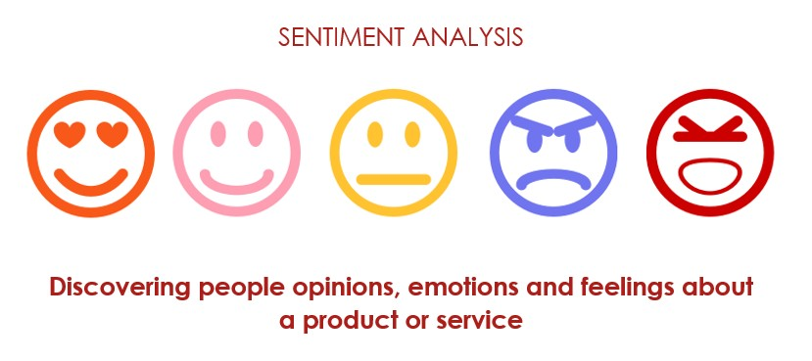


NLP Sentiment Analysis
Team No 1
Mr. Durga Prasad Kamisetti Mr. Gopi Dileep Kumar
Ms. Medoju Vaishnavi Mrs.Ramsheeda K
Mr. Shaik Abdul Khadar
11/07/2024
Copyrights © 2017 Innodatatics Inc. All Rights Reserved

Slide 2

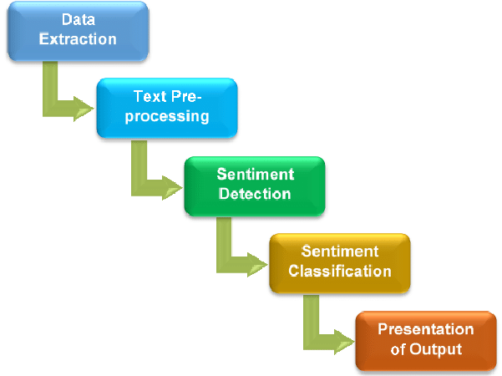
Business Problem
Sentiment analysis (or opinion mining) is a natural language processing (NLP) technique used to determine whether data is positive, negative or neutral. Sentiment analysis is often performed on textual data to help businesses monitor brand and product sentiment in customer feedback and understand customer needs.
Sentiment analysis is widely used in business intelligence and there are many various beneﬁts of sentiment analysis. Companies use sentiment analysis tools to unravel the sentiments in their customer conversations such as social media posts, surveys, reviews, call logs, chatbot/customer service conversations, etc.

Slide 3
OBJECTIVE
Extracting sentiment from customer reviews on a product. Need to deploy the end results (sentiment analysis) using Rshiny/ Streamlit /Flask etc.
The following procedure we followed to complete the project.
Visualizations
Box Plot
N-Gram
Bi-gram plot
Tri-gram
Heat map
Model Building
Logistic Regression
Support Vector Machine
Naive Bayes
Random Forest

Slide 4
Project Architecture / Project Flow
Data Cleaning: Data cleaning is the process of ﬁxing or removing incorrect, corrupted, incorrectly formatted, duplicate, or incomplete data within a dataset
Importing the Packages: Package import is deﬁned as a directed relationship between an importing namespace and a package whose members are imported into that namespace
Reading the Dataset: To read or write a data in Kaggle Kernel is the same as how you did in R or Python, the only thing to take note is the relative path to access the data.
EDA : Exploratory Data Analysis (EDA) is an analysis approach that identiﬁes general patterns in the data.
Visualization :Visualization is a simple technique that you can use to create a strong mental image of a future event
Detecting Collinearity : Collinearity, in statistics, correlation between predictor variables (or independent variables), such that they express a linear relationship in a regression model.
Model Building: Model building is a crucial phase in the data science process, where data is transformed into actionable insights and predictions.
Final Model: The machine learning model that we use to make predictions on new data is called the ﬁnal model.
Deployment : Model deployment is the process of integrating a machine learning model into a production environment where it can take in an input and return an output.

Slide 5
Exploratory Data Analysis (EDA) and
Feature Engineering

Slide 6
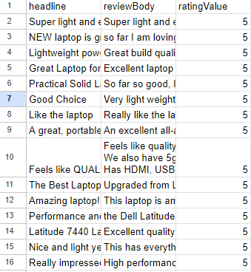
Data Set Details
The dataset should be scraped/extracted from ecommerce websites like amazon etc. Preferably amazon and focus only on extracting customer reviews , rest are not required.

Slide 7

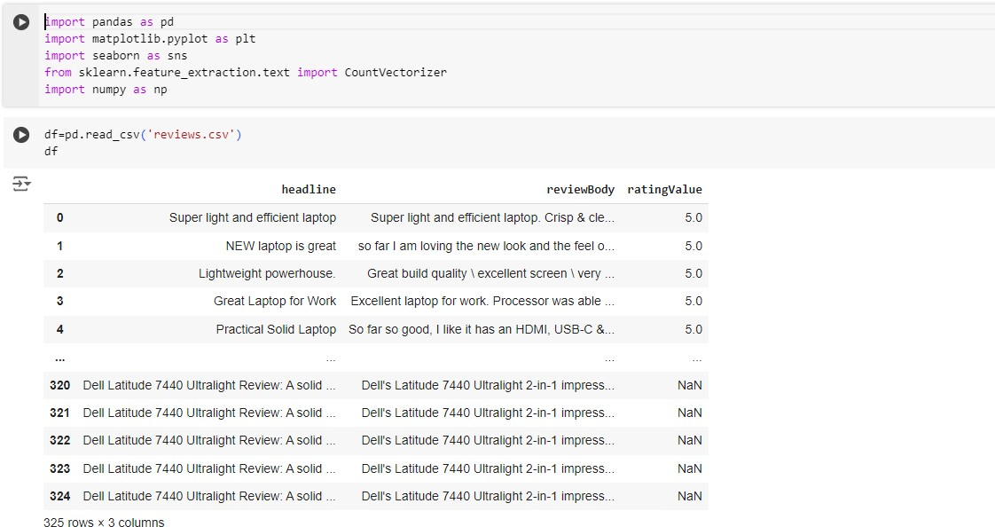
Sentimental Analysis
# Importing the packages
Copyrights © 2017 Innodatatics Inc. All Rights Reserved

Slide 8

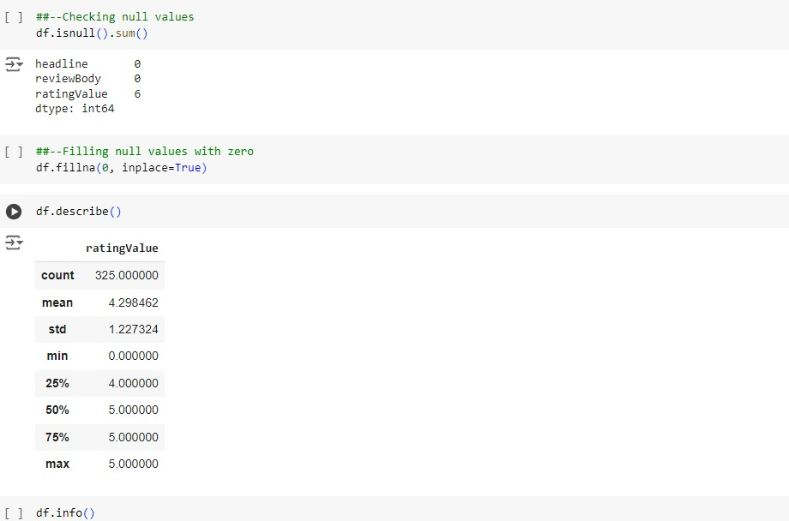
Sentimental Analysis
Copyrights © 2017 Innodatatics Inc. All Rights Reserved

Slide 9

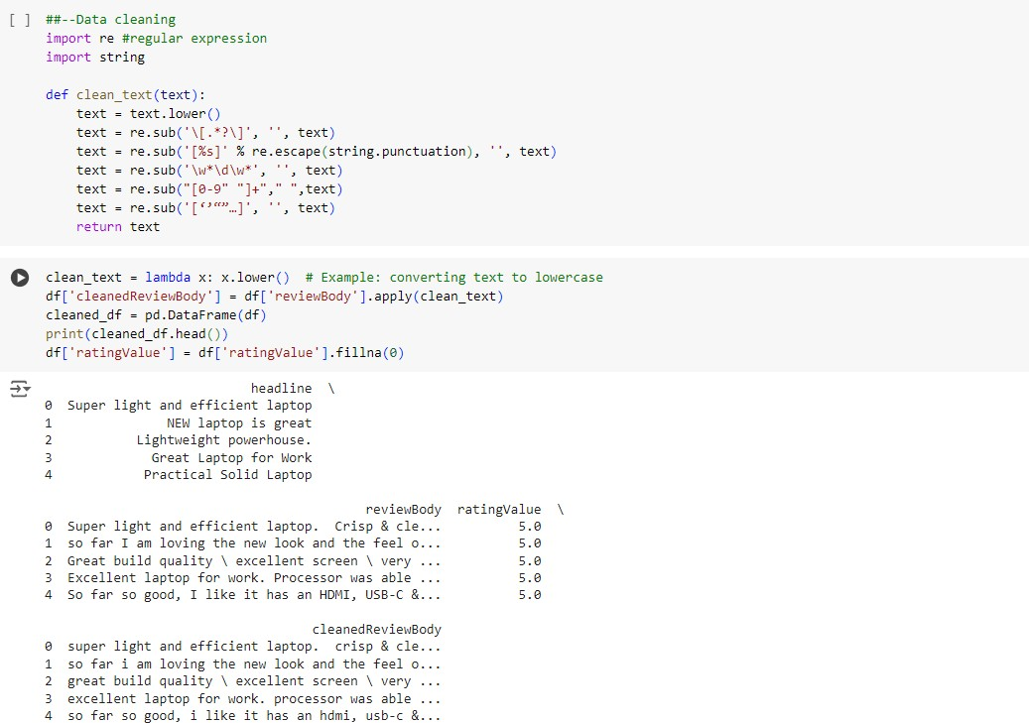
Sentimental Analysis
# Data cleaning
Copyrights © 2017 Innodatatics Inc. All Rights Reserved

Slide 10
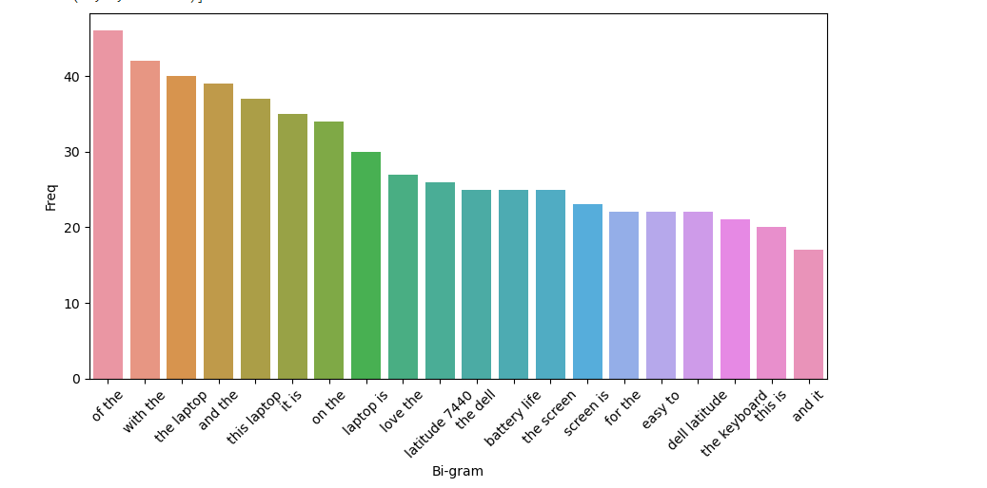
Feature Engineering/Visualization
Visualization is any technique for creating images, diagrams, or animations to communicate a message. Visualization through visual imagery has been an effective way to communicate both abstract and concrete ideas since the dawn of humanity.
#----N-Gram
#Bi-gram plot

Slide 11
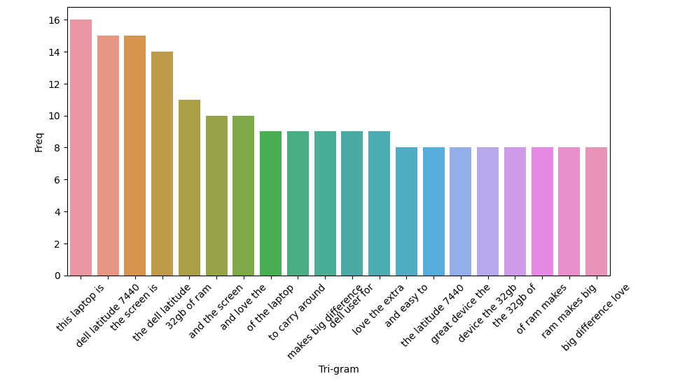
#Tri-gram

Slide 12
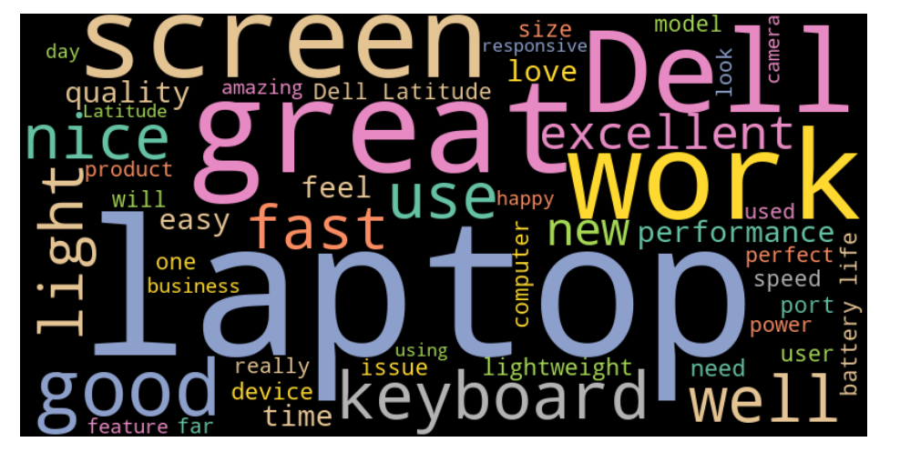
###---Word cloud

Slide 13
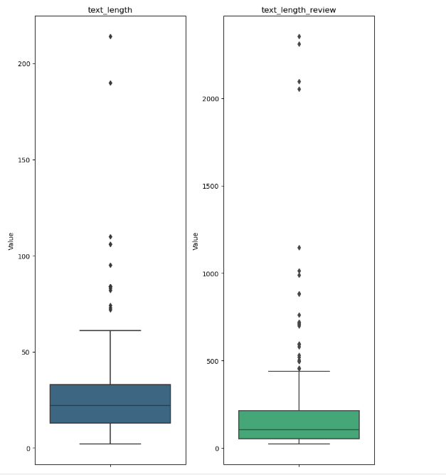
#---Box plot ----

Slide 14
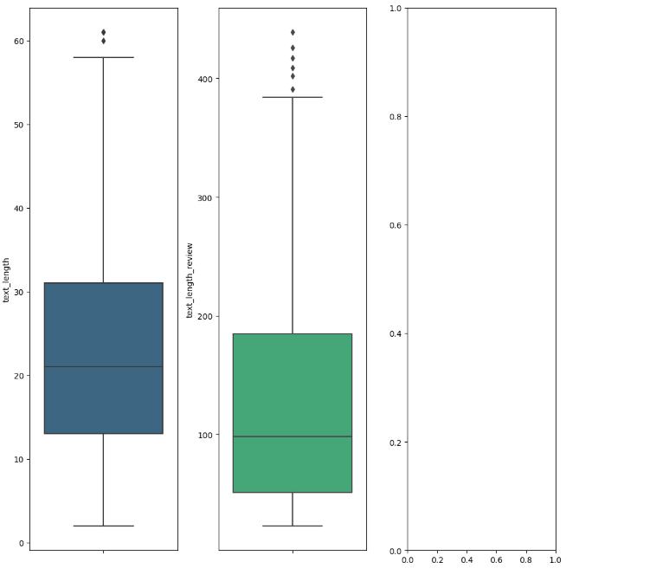
##--outliers---

Slide 15
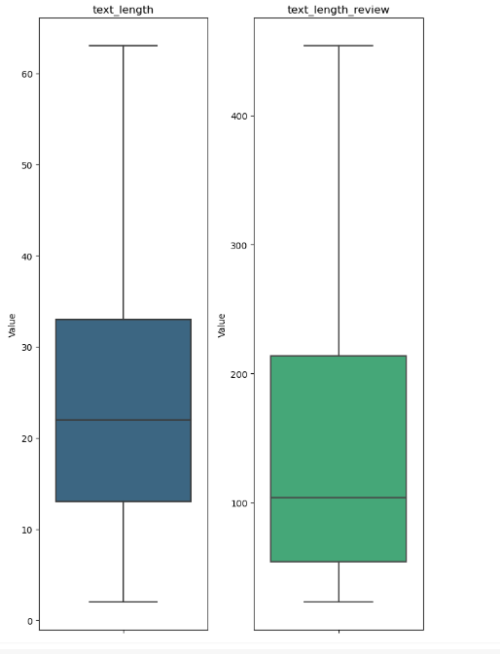
##--Capping for outliers

Slide 16
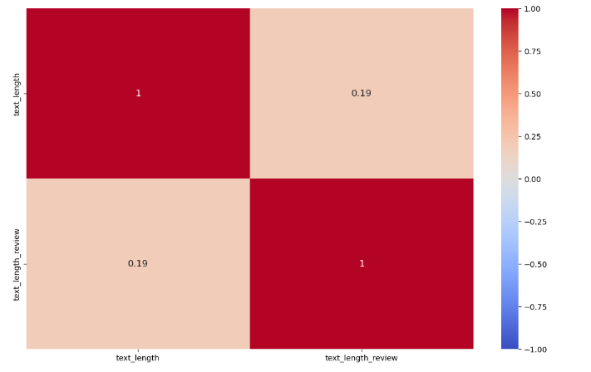
###---Heat map
A heatmap is a graphical representation of data that uses a system of color coding to represent different values. Heatmaps are used in various forms of analytics but are most commonly used to show user behavior on specific web pages or webpage templates

Slide 17
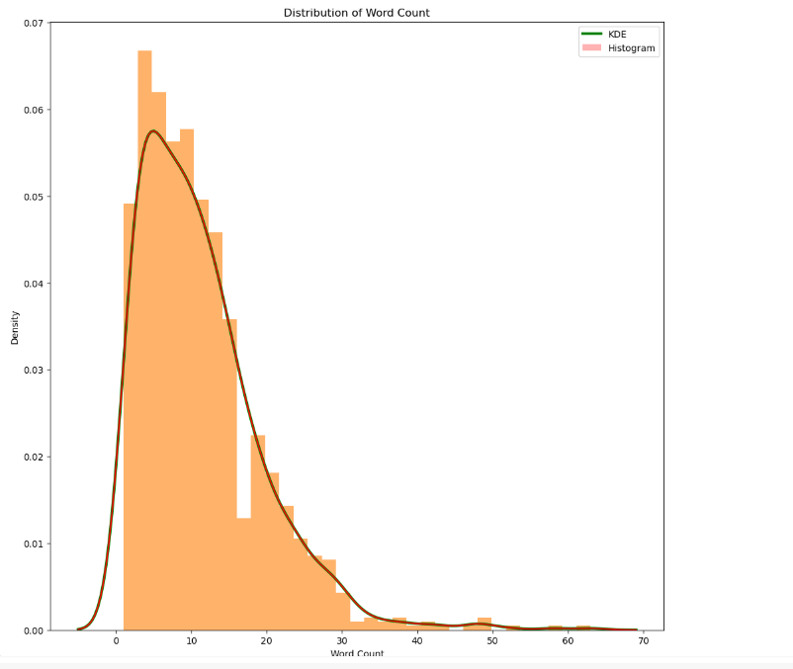
###--- Distribution plot for word count

Slide 18

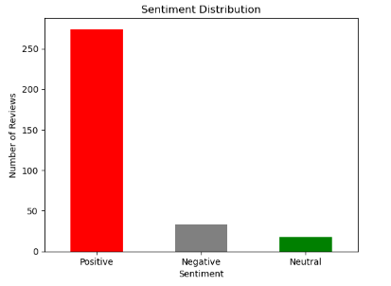
##---Count plot for Sentiment Distribution
□
Copyrights © 2017 Innodatatics Inc. All Rights Reserved

Slide 19
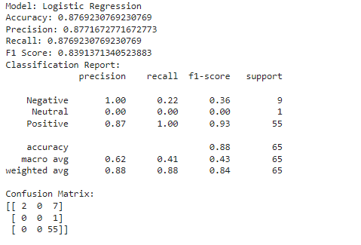
Model Building
Logistic Regression

Slide 20
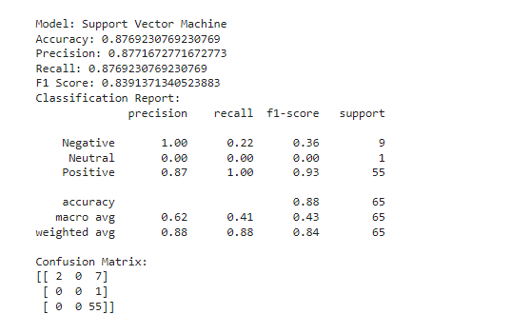
Support Vector Machine

Slide 21
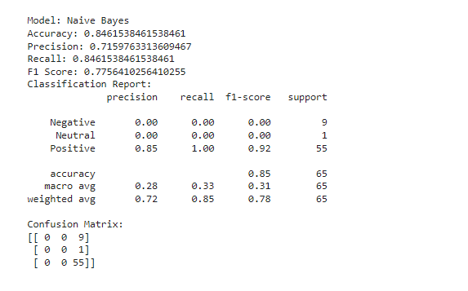
Naive Bayes

Slide 22
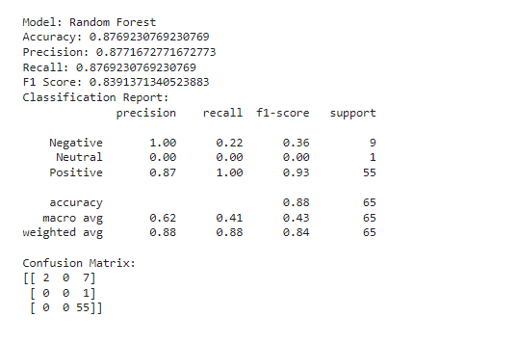
Random Forest

Slide 23
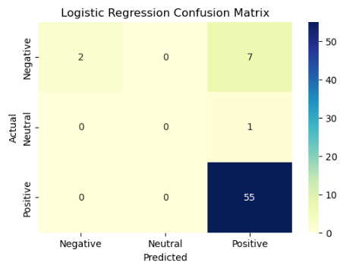
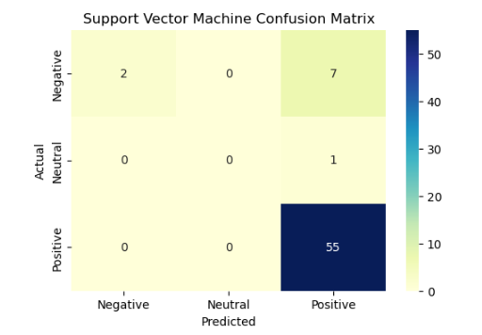
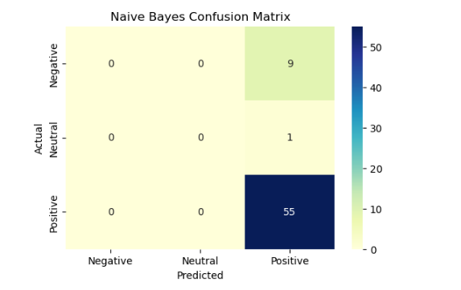
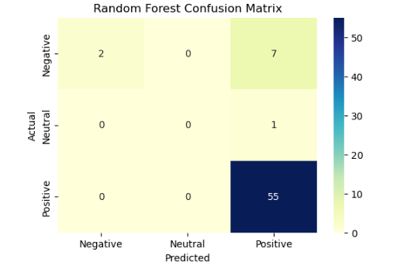
# Plot confusion matrix for each model

Slide 24
Model Building
Logistic Regression: Logistic regression is a supervised machine learning algorithm that accomplishes binary classification tasks by predicting the probability of an outcome, event, or observation. The model delivers a binary or dichotomous outcome limited to two possible outcomes: yes/no, 0/1, or true/false.
Support Vector Machine : A support vector machine (SVM) is a type of supervised learning algorithm used in machine learning to solve classification and regression tasks; SVMs are particularly good at solving binary classification problems, which require classifying the elements of a data set into two groups.
Naive Bayes: Naïve Bayes is part of a family of generative learning algorithms, meaning that it seeks to model the distribution of inputs of a given class or category. Unlike discriminative classifiers, like logistic regression, it does not learn which features are most important to differentiate between classes.
Random Forest :Random Forest is a supervised machine learning algorithm made up of decision trees. Random Forest is used for both classification and regression

Slide 25
Deployment

Slide 26
Deployment: Software deployment is the process of making software available to be used on a system by users and other programs. You might deploy software to create a backup copy of the software, to move the software to another system, or to create another SMP/E-serviceable copy for installing service or other products.
Streamlit: is a free and open-source framework to rapidly build and share beautiful machine learning and data science web apps. It is a Python-based library specifically designed for machine learning engineers. Stream lit is easy to use, requires minimal setup

Slide 27
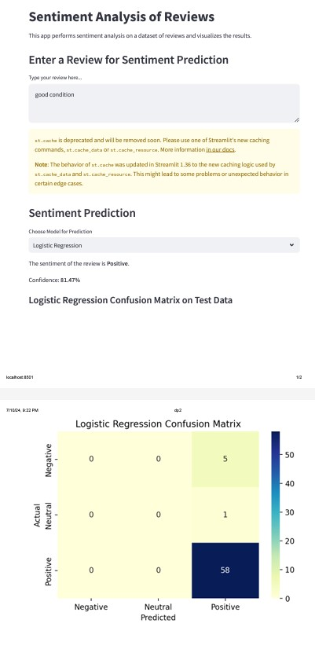
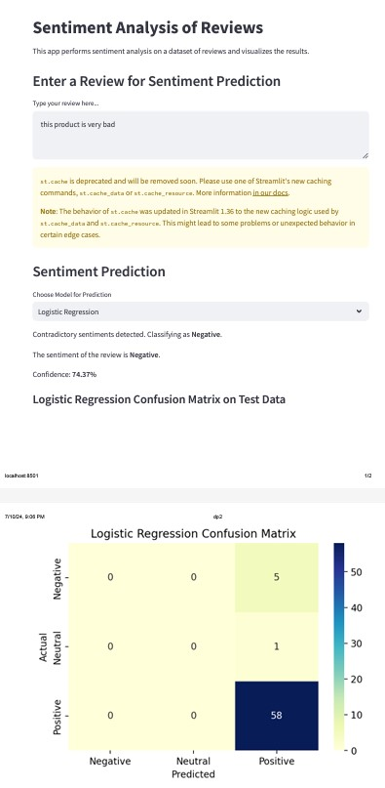
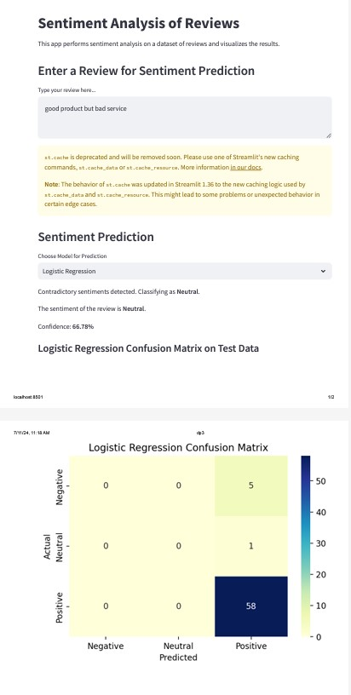
Logistic Regression

Slide 28
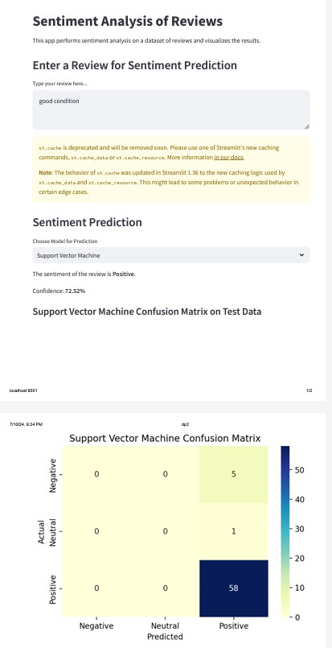
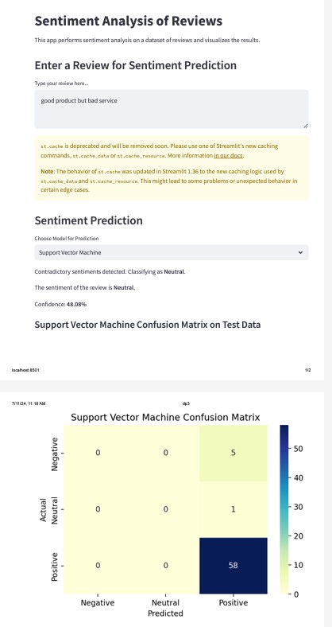
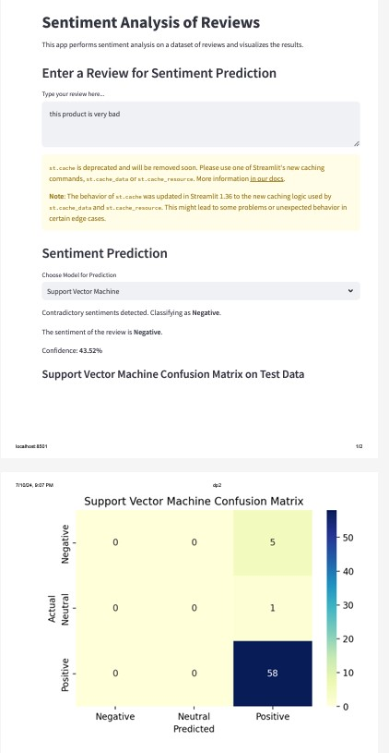
Support Vector Machine

Slide 29
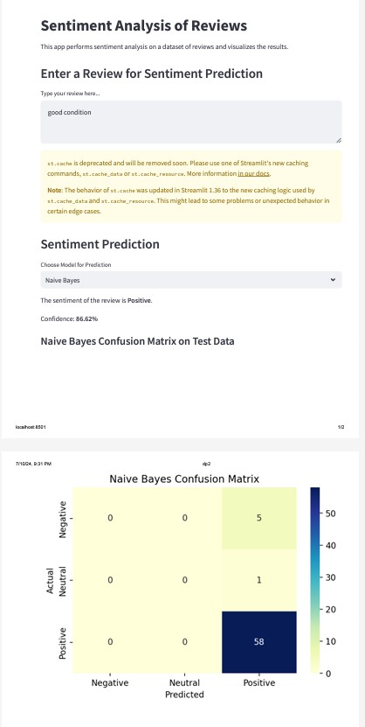
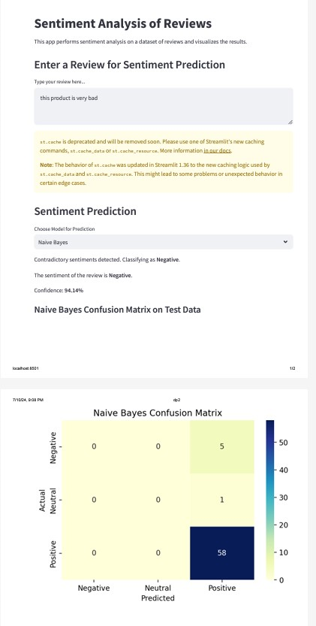

Naive Bayes

Slide 30
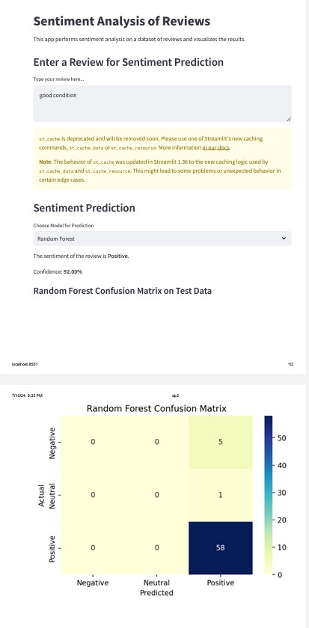
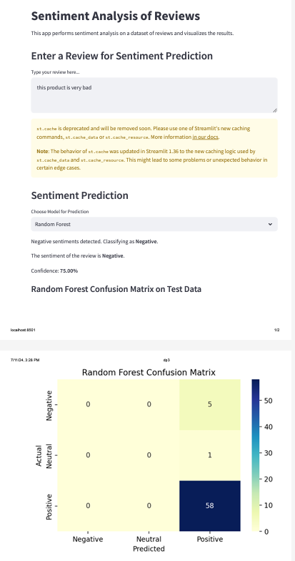
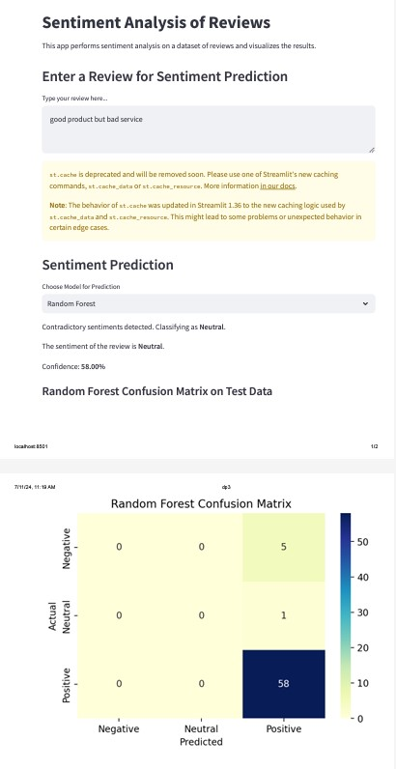
Random Forest

Slide 31
Challenges Faced?
Due to an imbalance in the dataset, the output was not accurate. The model was trained with more positive data, resulting in a higher number of positive feedback outputs.
Model accuracy depends on the presence of outliers.
We developed models for classifying positive and negative cases, but we did not create one for neutral classifications.

Slide 32
How did you overcome?
We have balanced the dataset using the SMOTE technique with various models.
After removing outliers, the accuracy score improved significantly. Therefore, eliminating outliers resulted in better accuracy.
Based on a Sentiment Score of 0.0 for the output, we classified the sentiment as Neutral. Currently, we have three outputs for the target column.

Slide 33
Thank you
Thank You

